Slide 1
ANNUAL GENERAL MEETING
2023
JANUARY 22, 2024
4:00pm – 4:30pm
LOCATION: ZOOM
The meeting will start momentarily.

Slide 2
HOUSE KEEPING RULES
The facilitator (host) will ask all attendees to use the following features within the Zoom room. Mute, Chat, and additional features (raise hand).
During the meeting, members will be asked to vote using polls. A poll will pop up on your screen, and members will vote i.e for, against or abstain. Once voting is completed, the host or co-host will share the results with all participants before proceeding to the next agenda item.
The Divisional council meetings will be recorded in order to capture the minutes of the meeting. Closed captioning will be turned on. OSLA Annual General Meetings - Ontario Library Association (accessola.com)

Slide 3
WELCOME
2023 Ontario School Library Association
Annual General Meeting

Slide 4
AGENDA
Welcome
Adoption of the Agenda
Approval of the Minutes
Acceptance of the OSLA Treasurer Report
OSLA President Report
New Business
Elections Report
Awards Report
Adjournment

Slide 5
MINUTES
Approval of the Minutes

Slide 6
OSLA FINANCIAL REPORT
OSLA Treasurer Report covers the period of September 1, 2022, to August 31, 2023
OSLA Treasurer Report

Slide 7
PRESIDENT'S REPORT
2023 President's Report

Slide 8
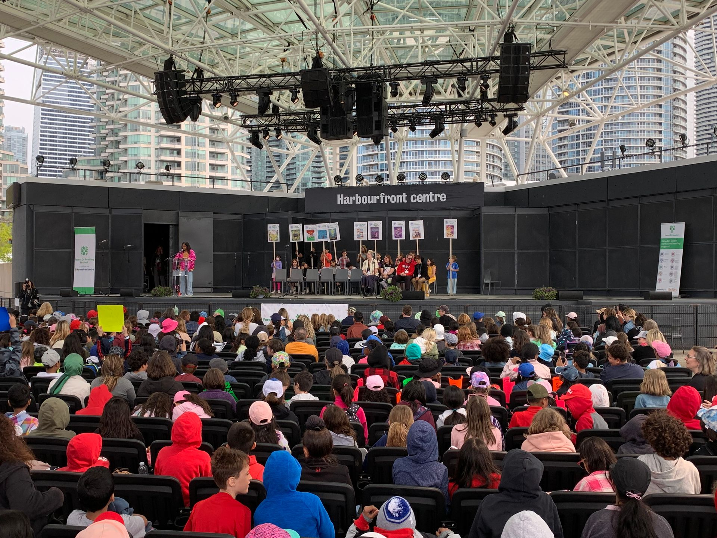
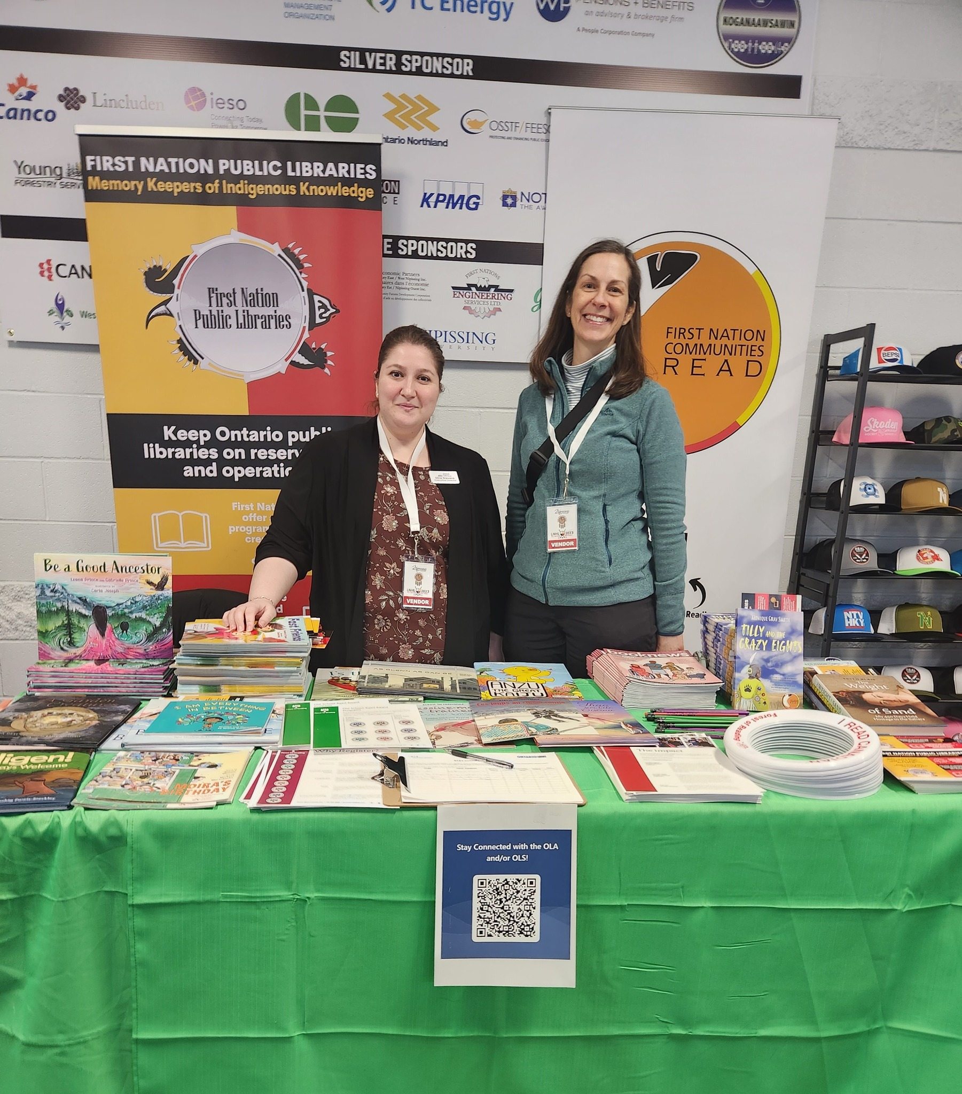
OLA 2023 IN REVIEW
5,000+ registrants
413 conference events
426 speakers
195 author signings
170 exhibitors
Return of the Forest of Reading Festival in-person
First hybrid Super Conference
OLA & OLS booth at Little Native Hockey League (LNHL) 2023
Michelle Arbuckle becomes Executive Director
500+ books given away!

Slide 9
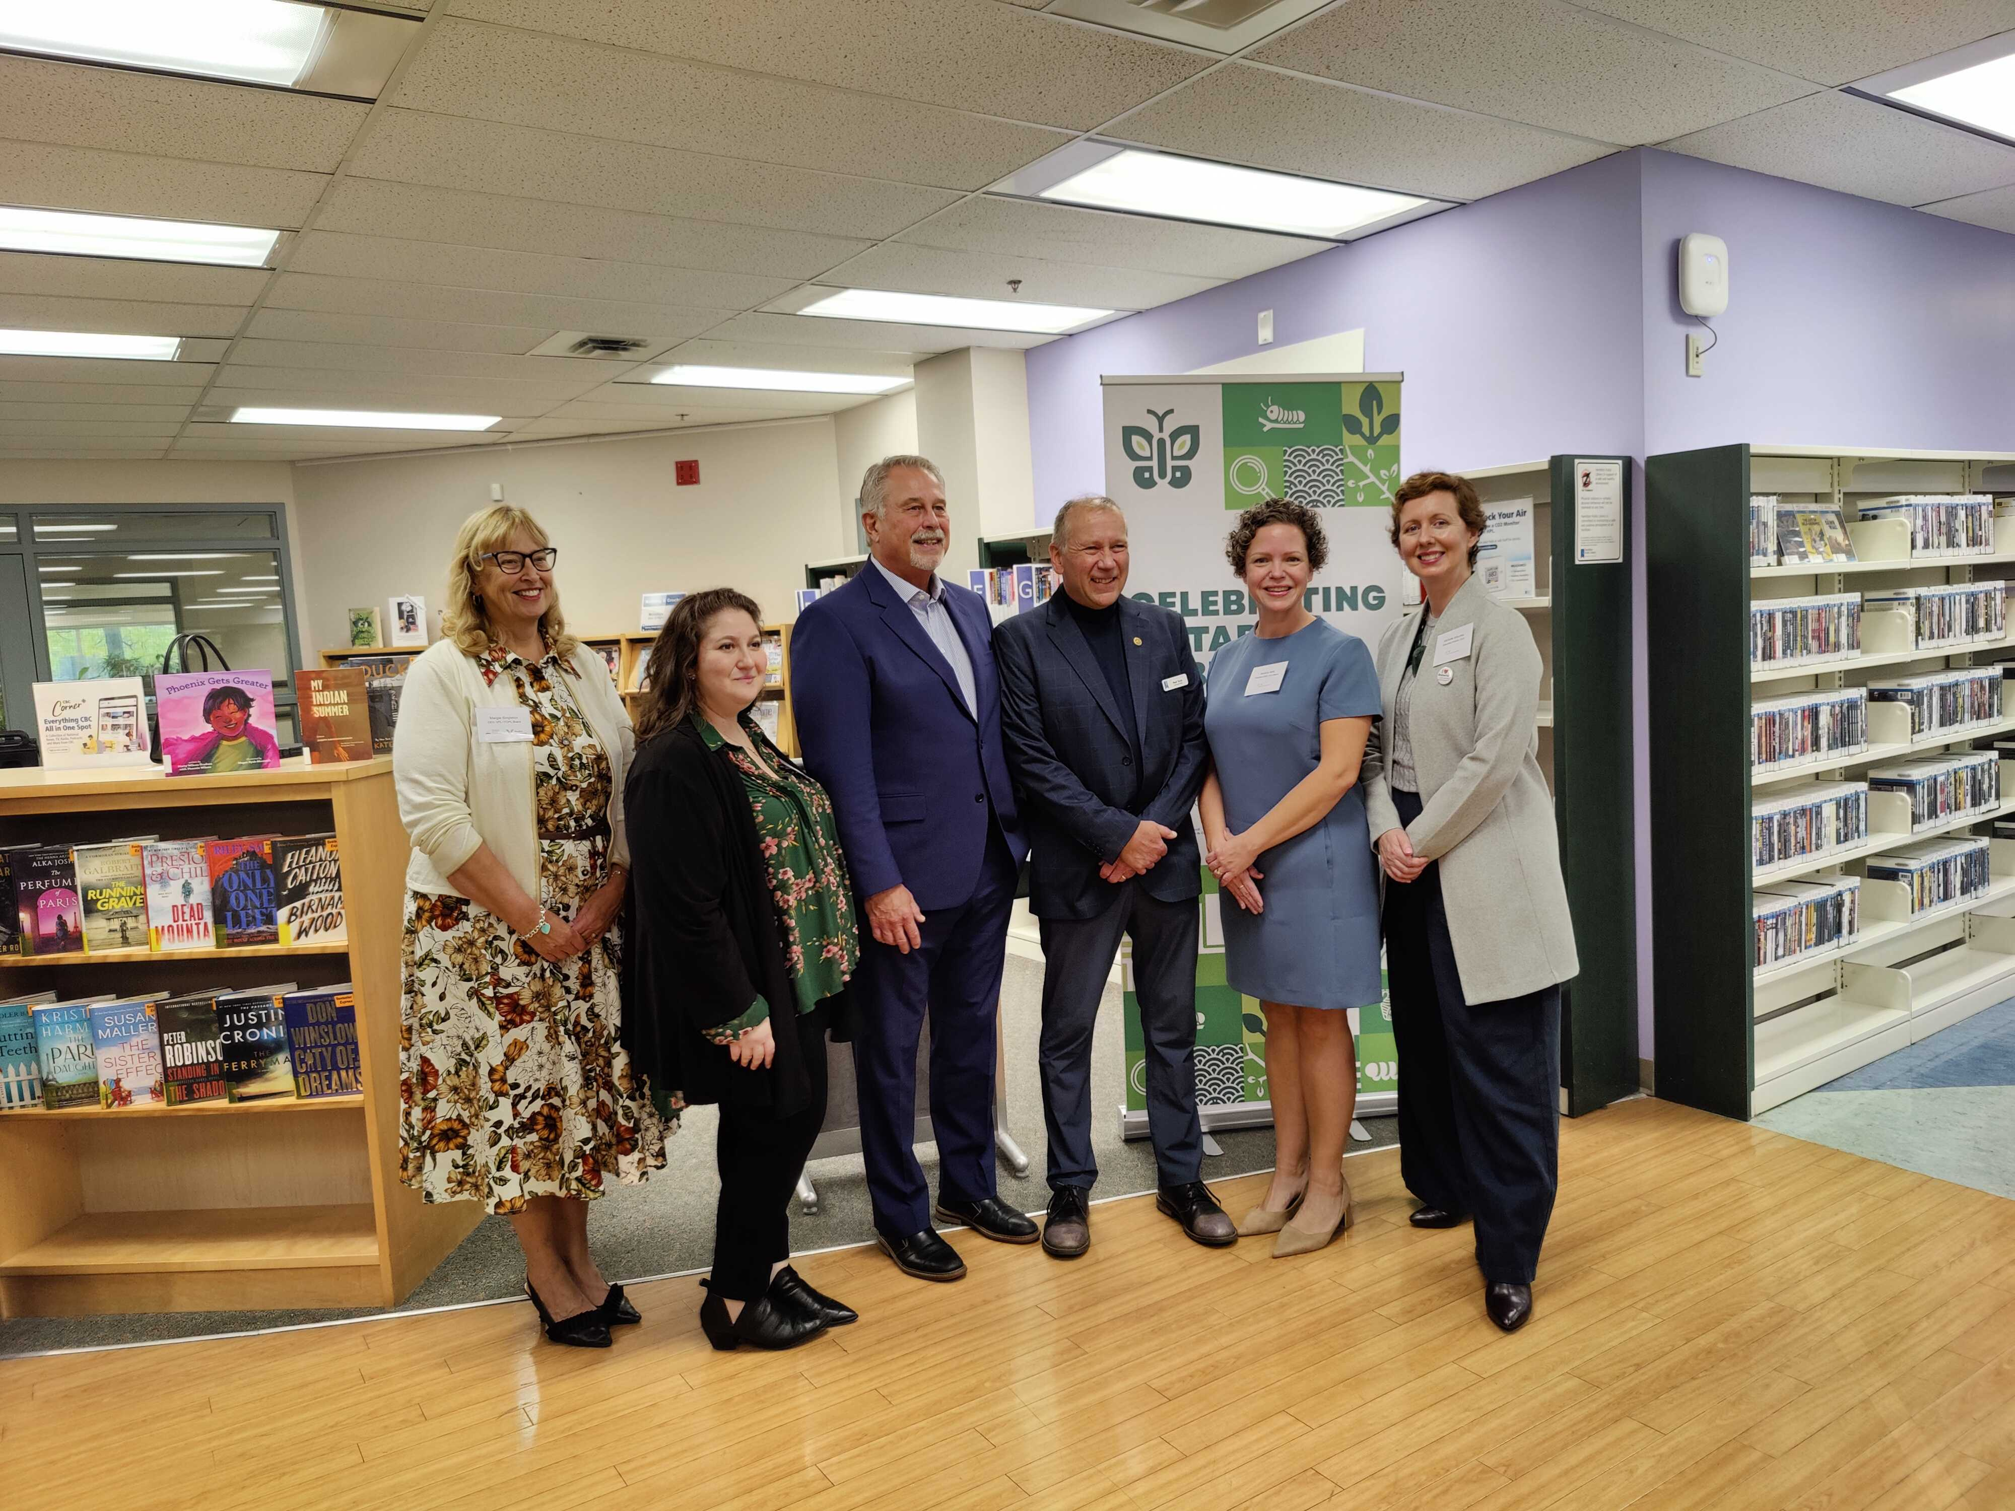
OLA 2023 IN REVIEW
Libraries for Life
Ontario Public Library Week
School Library Week
OPLW event at Hamilton PL
Meeting with Minister Lumsden

Slide 10
OLA 2023 IN REVIEW
Lisa MacVicar is hired as EDI Consultant and to develop an anti-racism strategy for OLA
OSLA publishes School Library Selection Guide
OLA Anti-Racism Committee formed
Statement on school boards banning & restricting books released
New governance model approved

Slide 11
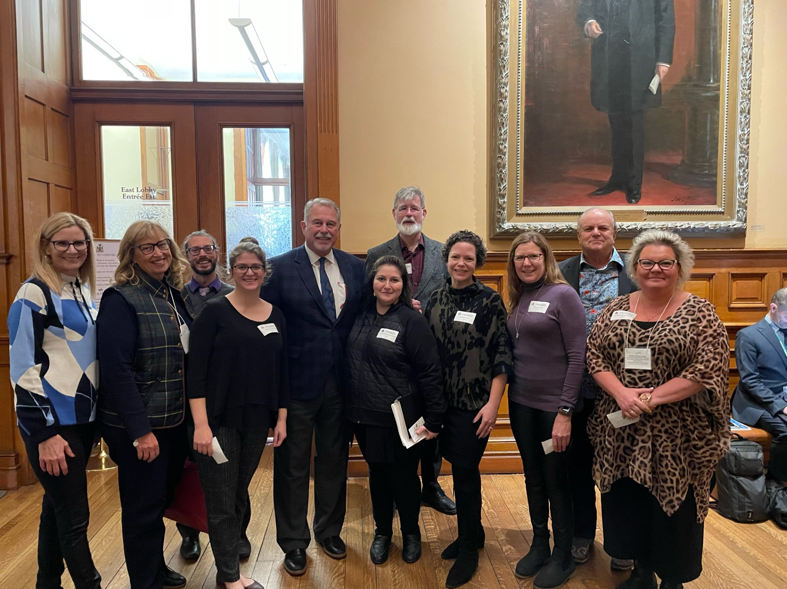
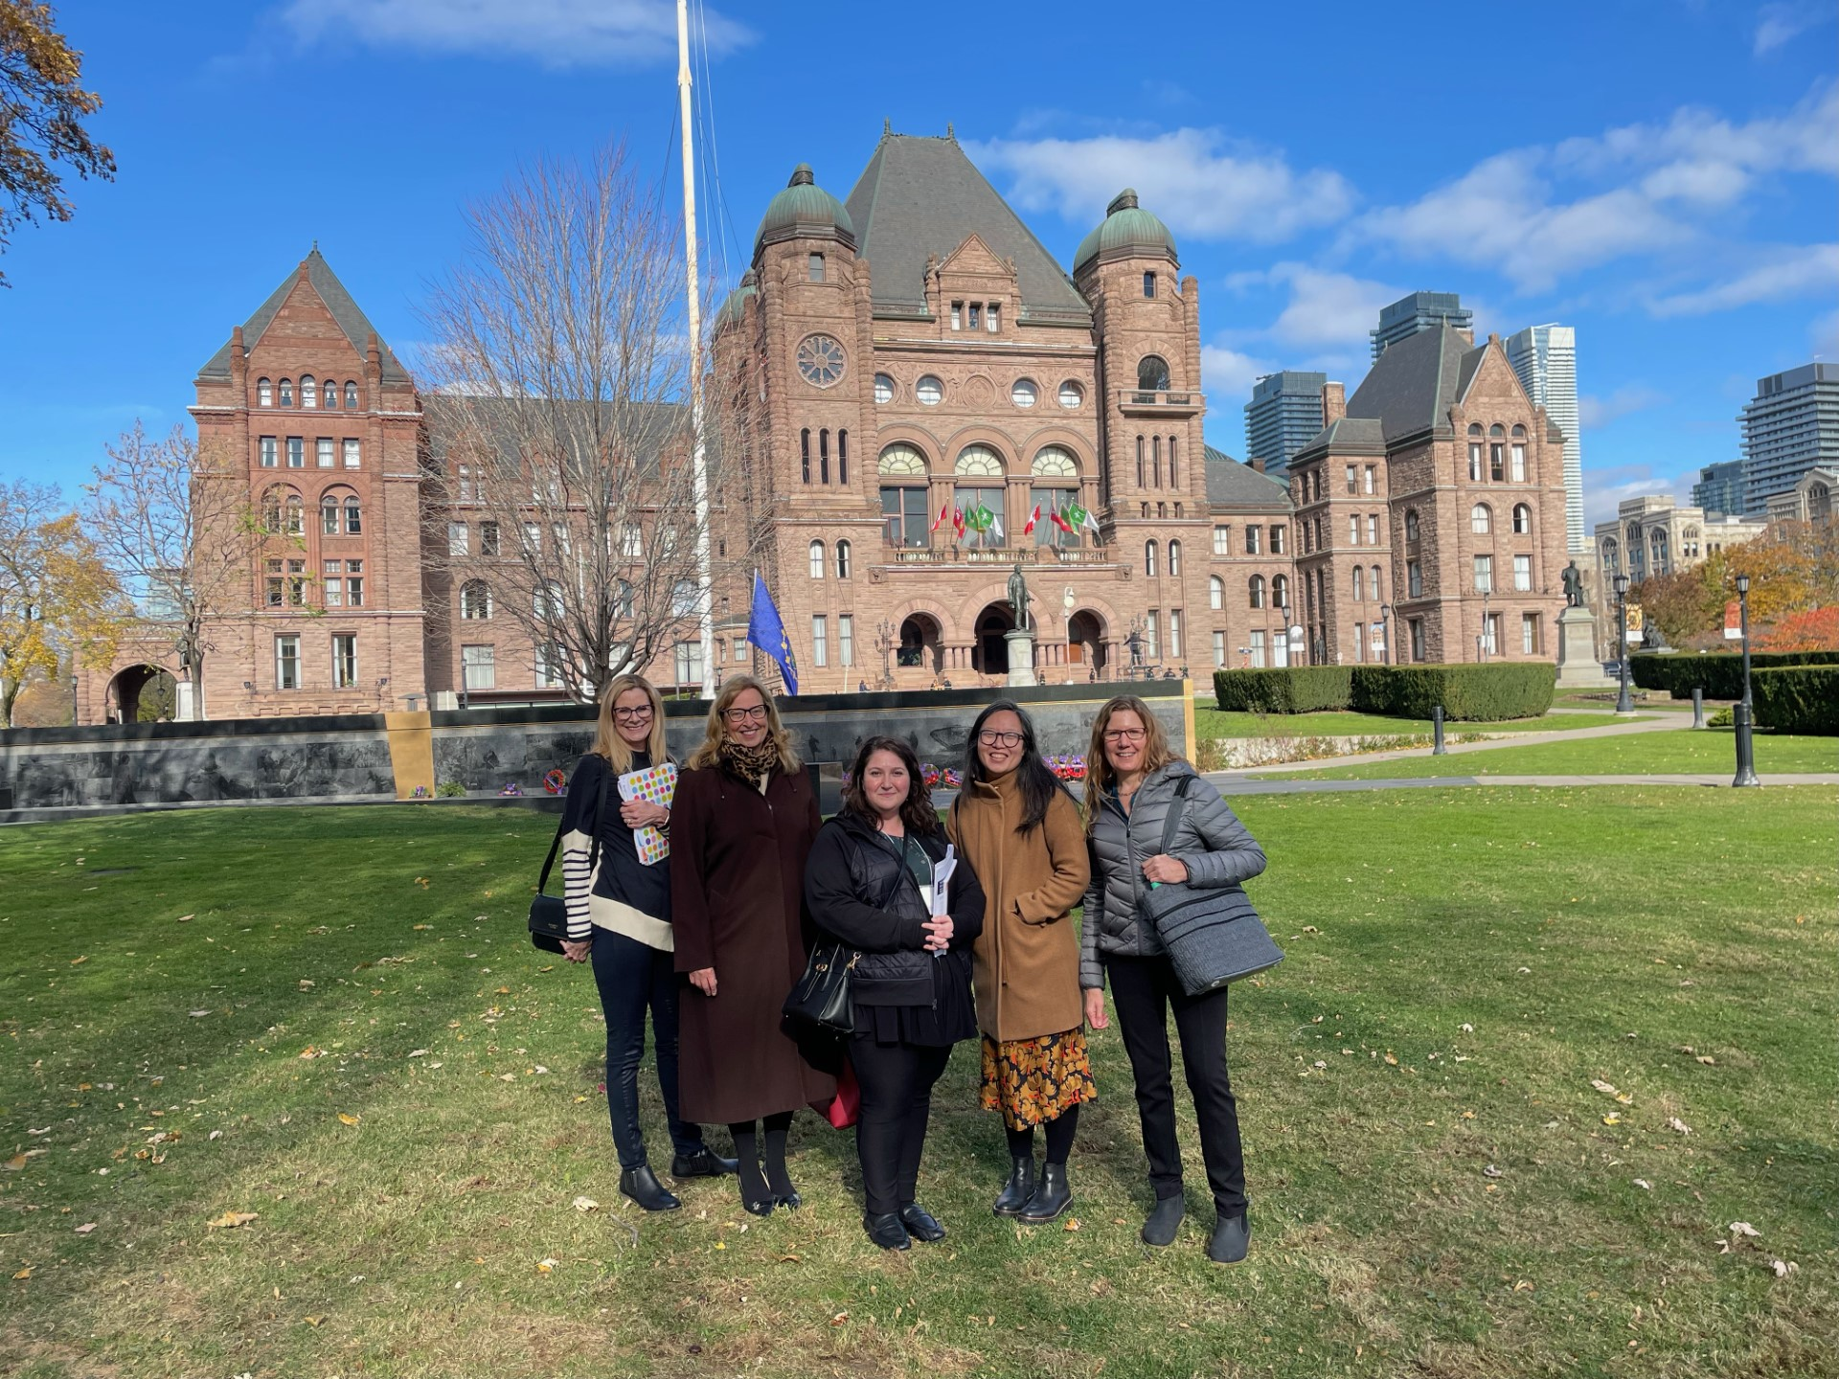
OLA 2023 IN REVIEW
Library Day at Queen's Park
20+ meetings with a broad, multi-partisan spectrum of elected and Ministry officials
Advanced our provincial government relations efforts
Raised profile of libraries

Slide 12
NEW BUSINESS

Slide 13
ELECTIONS REPORT
Wendy Burch-Jones is our new OSLA President for 2024
New Council Members
Jennifer Angle, HWDSB was acclaimed as the Vice-President / President-Elect Vacant – Northern Region Vacant – Central East Region
Returning OSLA Council Members for 2024
Johanna Gibson-Lawler – Past President / Treasurer
Ruth Gretsinger - Central West Region
Dawn Telfer - Southwestern Region
Lisa Lewis – Toronto Region Richard Reid – Mid–Central Region Sue Matthews – Eastern Region
Danny Neville - Teaching Librarian Editor-in-Chief

Slide 14
ELECTIONS REPORT
Farewell
Beth Lyons held the role of Past President/Treasurer for the 2023 year. She has been a guide and a mentor throughout the past few years for all the OSLA Council.
We are also saying goodbye to Shelley Merton, councilor from the Central East Region and we said goodbye to Kasey Whalley, the past editor of TingL.
Vacancy
Northern Region (Algoma, Cochrane, Nipissing, Parry Sound, Sudbury, Timiskaming, Kenora, Rainy River, Thunder Bay, North of Superior) Central East Region (Hastings, Kawartha, Northumberland, Peterborough, Prince Edward, Victoria, Trillium)
Notes:
Your commitment, dedication, and ongoing advocacy for school libraries is a joy to behold. Thanks, you to our Super Conference Planners, Dawn Telfer and Kate Johnson-MaGregor for their hard work in bringing the conference back in person with an enhanced digital stream.

Slide 15
AWARDS REPORT
OSLA Administrator of the Year - Peter Rewega - Toronto DSB
OSLA School Library Professional of the Year (School Library Technician) - Victoria Riddle - Hamilton Wentworth DSB
OSLA Teacher Librarian of the Year - Aimee Barber - Ottawa Carleton DSB
OSLA Special Achievement – No award this year
OLA Super Conference…
Join us on Thursday, January 25th @ 5:15 p.m. for OSLA’s Celebration: Awards and Launch of the Guide to the Selection and Deselection of School Library Resources

Slide 16
ADJOURNMENT

Slide 17
THANK YOU

Slide 18
DISCUSSION

